Slide 1
CSE 495 (Natural Language Processing) Lecture 11
NLP Metrics

Slide 2
Why Study NLP Evaluation Metrics
Whenever we build Machine Learning models, we need some metric to measure the model’s goodness.
“Goodness” of the model have multiple interpretations
Generally, we use it as the measure of a model's performance on new instances that weren’t a part of the training data
Determining whether the model being used for a specific task is successful depends on 2 key factors
Whether the evaluation metric we have selected is the correct one for our problem
Whether we are following the correct evaluation process

Slide 3
Evaluation Metrics to Use
The evaluation metric depends on the type of NLP task and the stage of the project
For example, during the model building and deployment phase, we use a different evaluation metric than the model in production
During development, ML metrics would suffice, but in production, we care about business impact; therefore, we rather use business metrics to measure the goodness of our model

Slide 4
Categories of Evaluation
We can categorize evaluation metrics into two
Intrinsic Evaluation — Focuses on intermediary objectives (i.e., the performance of an NLP component on a defined subtask)
Extrinsic Evaluation — Focuses on the performance of the final objective (i.e., the performance of the component on the complete application)
Stakeholders typically care about extrinsic evaluation since they’d want to know how good the model is at solving the business problem at hand
However, it’s still important to have intrinsic evaluation metrics for the AI team to measure how they are doing

Slide 5
Conventional Metrics
Accuracy
Denotes the fraction of times the model makes a correct prediction compared to its total predictions
Best used when the output variable is categorical or discrete
For example, how often a sentiment classification algorithm is correct
Precision
Evaluates the percent of true positives identified given all positive cases
Particularly helpful when identifying positives are more important than overall accuracy
For example, if identifying a cancer that is prevalent 1% of the time, a model that always outputs “negative” will be 99% accurate, but 0% precise
Recall
The percent of true positives versus combined true positives and false negatives
In the example with a rare cancer that is prevalent 1% of the time, if a model creates totally random predictions (50/50), it will have 50% accuracy (50/100), 50% precision (0.5/1), and 1% recall (0.5/50)

Slide 6
Conventional Metrics
F1 Score
Combines precision and recall to give a single metric — both completeness and exactness.
(2 * Precision * Recall) / (Precision + Recall).
Used together with accuracy, and useful in sequence-labeling tasks, such as entity extraction, and retrieval-based question answering
AUC
Area Under Curve; Combines true positives vs false positives as threshold for prediction is varied
Used to measure the quality of a model independent of the prediction threshold and to find the optimal prediction threshold for a classification task.
MRR
Mean Reciprocal Rank; Evaluate the responses retrieved given their probability of being correct
The mean of the reciprocal of the ranks of the retrieved results
Used heavily in all information-retrieval tasks, including article search and e-commerce search.
MAP
Mean average precision, calculated across each retrieved result. Used in information-retrieval tasks.

Slide 7
BLEU – Metric for MT
Bilingual Evaluation Understudy or BLEU is a precision-based metric used for evaluating the quality of machine-translated text
It uses 𝑛-gram overlaps between the reference (human annotation) and the hypothesis (machine generated text)
The BLEU score is a number between zero and one that measures the similarity of the machine-translated text to a set of high-quality reference translations.
A value of 0 means that the machine-translated output has no overlap with the reference translation (low quality)
While a value of 1 means there is perfect overlap with the reference translations (high quality).
It has been shown that BLEU scores correlate well with the human judgment of translation quality
Note that even human translators do not achieve a perfect score of 1.0.
Central Idea:
“The closer a machine translation is to a professional human translation, the better it is.”

Slide 8
What is BLEU? A Big Picture
Requires multiple good reference translations
Depends on modified n-gram precision (or co-occurrence)
Co-occurrence: if translated sentence hit n-gram in any reference sentences
Computes Per-corpus n-gram co-occurrence
n can have several values and a weighted sum is computed
Penalizes very brief translation

Slide 9
N-gram Precision: an Example
(Machine generated) Candidate 1: It is a guide to action which ensures that the military always obey the commands of the party.
(Machine generated) Candidate 2: It is to insure the troops forever hearing the activity guidebook that party direct.
Clearly Candidate 1 is better
(Human annotation) Reference 1: It is a guide to action that ensures that the military will forever heed Party commands.
(Human annotation) Reference 2: It is the guiding principle which guarantees the military forces always being under the command of the Party.
(Human annotation) Reference 3: It is the practical guide for the army always to heed directions of the party

Slide 10
N-gram Precision
To rank Candidate 1 higher than 2
Just count the number of N-gram matches
The match could be position-independent
Reference could be matched multiple times
No need to be linguistically-motivated

Slide 11
BLEU – Example : Unigram Precision
Candidate 1: It is a guide to action which ensures that the military always obey the commands of the party.
(Human annotation) Reference 1: It is a guide to action that ensures that the military will forever heed Party commands.
(Human annotation) Reference 2: It is the guiding principle which guarantees the military forces always being under the command of the Party.
(Human annotation) Reference 3: It is the practical guide for the army always to heed directions of the party.
1-gram match : 17
1-gram precision: 17/18

Slide 12
Example : Unigram Precision (cont.)
Candidate 2: It is to insure the troops forever hearing the activity guidebook that party direct.
(Human annotation) Reference 1: It is a guide to action that ensures that the military will forever heed Party commands.
(Human annotation) Reference 2: It is the guiding principle which guarantees the military forces always being under the command of the Party.
(Human annotation) Reference 3: It is the practical guide for the army always to heed directions of the party.
1-gram match : 8, 1-gram precision : 4/7

Slide 13
Issue of N-gram Precision
What if some words are over-generated?
e.g. “the”
An extreme example
Candidate: the the the the the the the.
(Human annotation) Reference 1: The cat is on the mat.
(Human annotation) Reference 2: There is a cat on the mat.
1-gram match: 7, 1-gram precision: 1 (Something wrong)
Intuitively : reference word should be exhausted after it is matched.

Slide 14
Modified N-gram Precision : Procedure
Procedure
Count the max number of times a word occurs in any single reference
Clip the total count of each candidate word
Modified N-gram Precision equal to
Clipped count/Total no. of candidate word
Example:
Ref 1: The cat is on the mat.
Ref 2: There is a cat on the mat.
“the” has max count 2
Unigram count = 7
Clipped unigram count = 2
Total no. of counts = 7
Modified-ngram precision:
Clipped count = 2
Total no. of counts =7
Modified-ngram precision = 2/7

Slide 15
How does a modified precision score help?
Modified n-gram precision score captures two aspects of translation: adequacy and fluency
A translation using the same words as in the references tends to satisfy adequacy
The longer n-gram matches between candidate and reference translation account for fluency

Slide 16
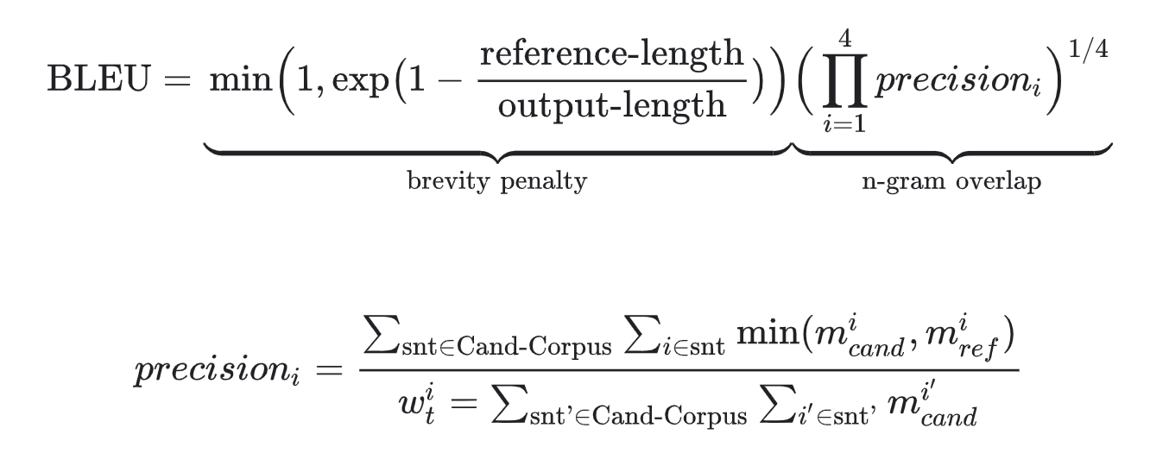
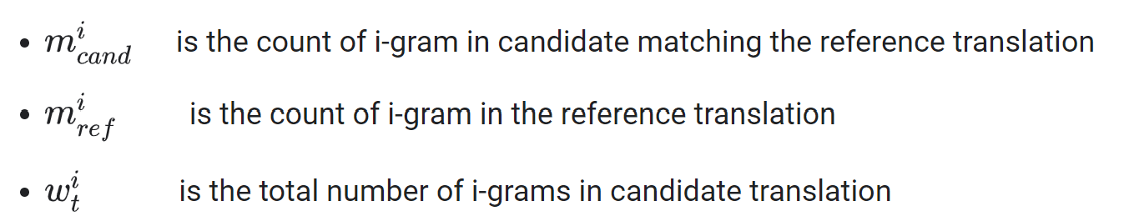
BLEU Score Formula
The formula consists of two parts: the brevity penalty and the n-gram overlap.
Brevity Penalty
Penalizes generated translations that are too short compared to the closest reference length with exponential decay
Compensates for the fact that the BLEU score has no recall term
N-Gram Overlap
The n-gram overlap counts how many unigrams, bigrams, trigrams, and four-grams (i=1,...,4) match their n-gram counterpart in the reference translations
Unigrams account for adequacy, while longer n-grams account for fluency of the translation. To avoid overcounting, the n-gram counts are clipped to the maximal n-gram count occurring in the reference

Slide 17
Size of the translations
Brevity penalty is added to penalize too short translations.
Brevity Penalty(BP) will be 1.0 when the candidate translation length is the same as any reference translation length
The closest reference sentence length is the “best match length.”
With the brevity penalty, we see that a high-scoring candidate translation will match the reference translations in length, in word choice, and word order.
Neither the brevity penalty nor the modified n-gram precision length directly considers the source length; instead, they only consider the range of reference translation lengths of the target language

Slide 18
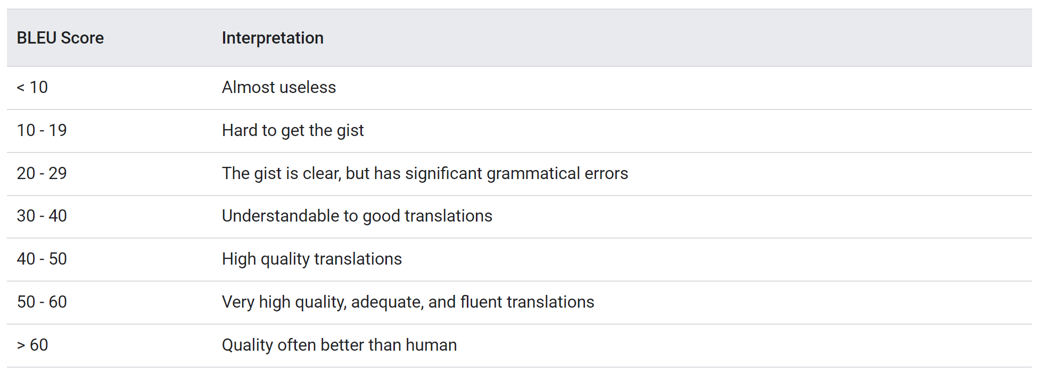
BLUE Interpretation
Trying to compare BLEU scores across different corpora and languages is strongly discouraged
Even comparing BLEU scores for the same corpus but with different numbers of reference translations can be highly misleading
However, as a rough guideline, the following interpretation of BLEU scores (expressed as percentages rather than decimals) might be helpful.

Slide 19
BLEU Properties
BLEU is a Corpus-based Metric
The BLEU metric performs poorly when used to evaluate individual sentences.
n-gram statistics for individual sentences are less meaningful, BLEU is by design a corpus-based metric; that is, statistics are accumulated over an entire corpus when computing the score.
No distinction between content and function words
The BLEU metric does not distinguish between content and function words; that is, a dropped function word like "a" gets the same penalty as if the name "NASA" were erroneously replaced with "ESA."
Not good at capturing the meaning and grammar of a sentence
The drop of a single word like "not" can change the polarity of a sentence. Also, taking only n-grams into account with n≤4 ignores long-range dependencies and thus BLEU often imposes only a small penalty for ungrammatical sentences.
Normalization and Tokenization
Before computing the BLEU score, the reference and candidate translations are normalized and tokenized. The choice of normalization and tokenization steps significantly affects the final BLEU score.

Slide 20
ROGUE
ROGUE stands for Recall-Oriented Understudy for Gisting Evaluation
Recall based, unlike BLEU, which is Precision based
ROUGE metric includes a set of variants: ROUGE-N, ROUGE-L, and ROUGE-S.
ROUGE-N is like BLEU-N in counting the 𝑛-gram matches between the machine generated and human annotation
Used for evaluating automatic summarization and machine translation in natural language processing
The metrics compare an automatically produced summary or translation against a set of references (human-produced) summary or translation

Slide 21
ROUGE-N
ROUGE-N measures the number of matching ‘n-grams’ between our model-generated text and a ‘reference.’
In ROUGE-N, the N represents the n-gram that we are using
ROUGE-1 measures the match of unigrams between our model's output and the reference
ROUGE-2 and ROUGE-3 will use bigrams and trigrams respectively
Once we have decided which N to use, we now decide whether to calculate the ROUGE recall, precision, or F1 score

Slide 22
ROUGE-L
ROUGE-L measures the longest common subsequence (LCS) between our model’s output and the reference
We count the longest sequence of tokens that are shared between the two
A longer shared sequence would indicate more similarity between the two sequences
Recall and precision are also calculated based on reference and the model’s output

Slide 23
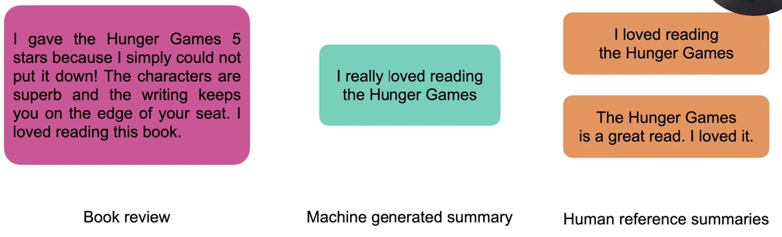
ROUGE Demo

Slide 24
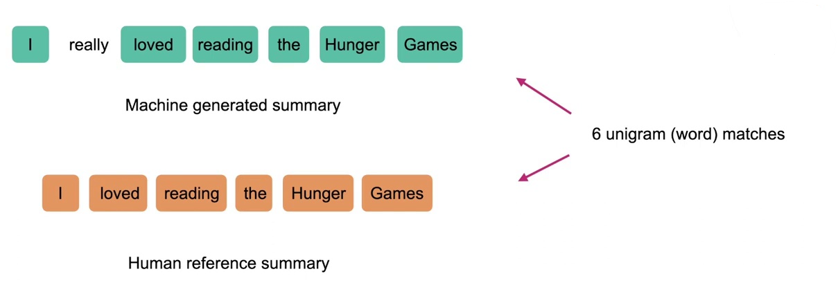
ROUGE Demo

Slide 25
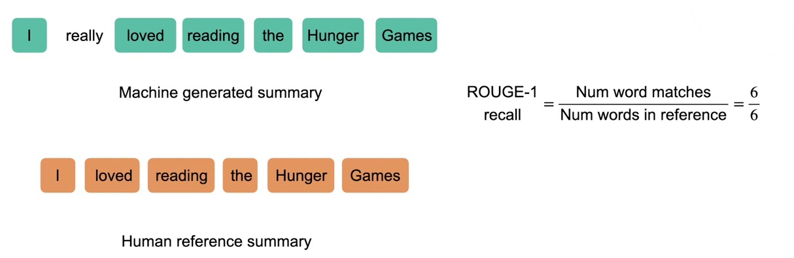

Slide 26
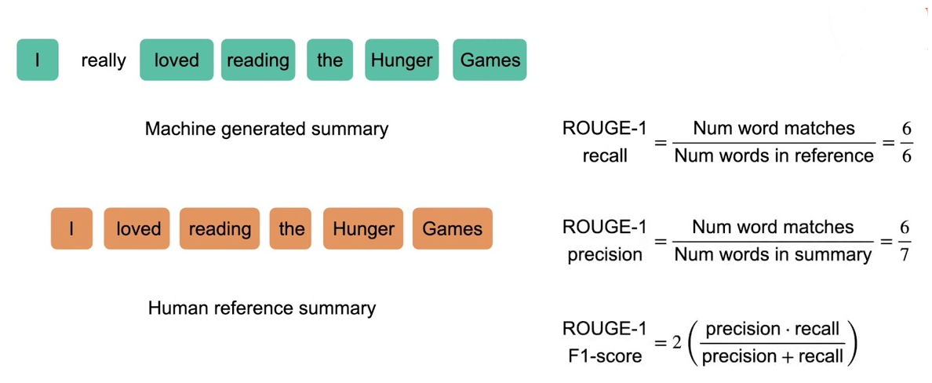
ROUGE Demo

Slide 27
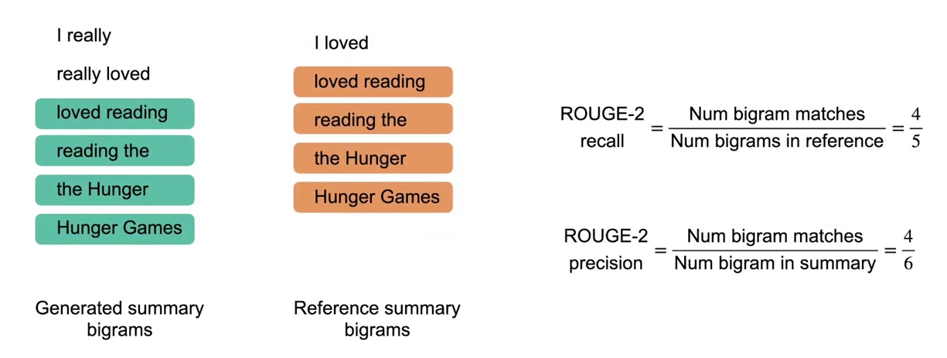
ROUGE Demo

Slide 28
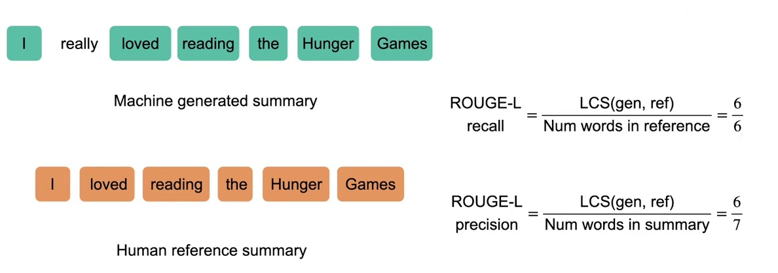
ROUGE Demo

Slide 29
ROUGE-S
ROUGE-S skips at most (n-1) grams to find the n-grams
Using this metric allows us to search for consecutive words from the reference text that appear in the model’s output but are separated by other words
If we encounter the bigram “the fox,” the original ROUGE-2 metric would only match this if this exact sequence was found in the model’s output
If the model instead outputs “the brown fox,” no match would be found.
ROUGE-S compensates for that
ROUGE-S allows us to add a degree of leniency to the n-gram matching

Slide 30
ROUGE Drawbacks
ROUGE cannot differentiate words with the same meaning as it measures syntactical matches rather than semantics.
If we had two sequences that had the same meaning but used different words to express that meaning, they could be assigned a low ROUGE score.

Slide 31
BLEU vs ROUGE
BLEU focuses on precision: how many words (and/or n-grams) in the candidate model outputs appear in the human reference.
ROUGE focuses on recall: how many words (and/or n-grams) in the human references appear in the candidate model outputs.
But ROUGE also have precision/f1 versions

Slide 32
Perplexity
Perplexity is an evaluation metric for language models
A metric that quantifies how uncertain a model is about the predictions it makes
Low perplexity only guarantees a model is confident, not accurate, but it often correlates well with the model’s final real-world performance, and it can be quickly calculated using just the probability distribution the model learns from the training dataset

Slide 33
Perplexity
What makes a good language model?
We want our model to assign high probabilities to sentences that are real and syntactically correct, and low probabilities to fake, incorrect, or highly infrequent sentences
Assuming our dataset is made of sentences that are in fact real and correct, this means that the best model will be the one that assigns the highest probability to the test set
Intuitively, if a model assigns a high probability to the test set, it means that it is not surprised to see it (it’s not perplexed by it), which means that it has a good understanding of how the language works

Slide 34
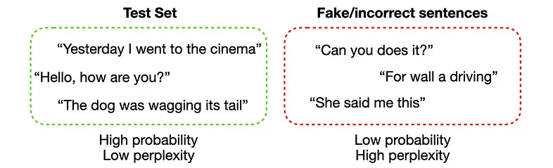
Perplexity example

Slide 35
Normalization of the Score
Datasets can have varying numbers of sentences, and sentences can have varying numbers of words
Adding more sentences introduces more uncertainty, so other things being equal a larger test set is likely to have a lower probability than a smaller one
A metric should be independent of the size of the dataset
We could obtain this by normalizing the probability of the test set by the total number of words, which would give us a per-word measure

Slide 36

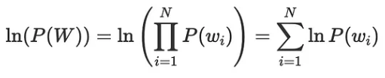
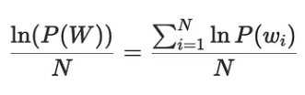
Normalization
Probability of the test set:
How do we normalize this probability? It’s easier to do it by looking at the log probability, which turns the product into a sum
We can now normalize this by dividing with N to obtain the per-word log probability:

Slide 37
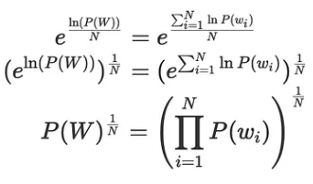
Formula manipulation of normalization
… and then remove the log by exponentiating:

Slide 38
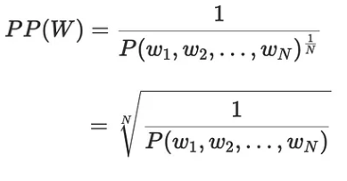
Final form of the formula
Now going back to our original equation for perplexity, we can see that we can interpret it as the inverse probability of the test set, normalized by the number of words in the test set:
Since we’re taking the inverse probability, a lower perplexity indicates a better model

Slide 39
Perplexity Conclusion
Perplexity is a metric used to judge how good a language model is
We can define perplexity as the inverse probability of the test set, normalized by the number of words:
The main disadvantage of perplexity is, it can be hard to make comparisons across datasets
Each dataset has its own distribution of words, and each model has its own parameters
This makes it difficult to compare the performances of models trained on different datasets directly

